Slide 1

Subject: Python for Computational Problem Solving (PCPS)
Subject Code: UE23CS151A
SEMESTER – I
“BANK MANAGEMENT SYSTEM”
Team details:
Sneh Patel-PES2UG23CS584
Tahir Shafiq-PES2UG23CS639
Sujoy Sen-PES2UG23CS621
Under the guidance of,
Ruby Dinakar
Asst. Prof
Dept. of CSE PES University

Slide 2
Outline
Problem Statement
Team Roles and Responsibilities.
List of inbuilt modules with its features highlighted for each
Implementation Details – Pseudocode / Algorithm
Results and Discussion – Screenshots of outputs
Learning from this project
Conclusion
Future Work
References – Textbooks/ web Links/ Any resource used as reference

Slide 3

PROBLEM STATEMENT
We organized the Banking Software, making it useful, compatible and efficient for the end users. We inculcated stock analysis along with banking system making it smooth for the users to invest in stocks.

Slide 4
TEAM ROLES AND RESPONSIBILITIES
Sneh Patel- Wrote the code withdrawing and depositing any money from the users, checking the bank balance of the user and displaying the bank statement.
Sujoy Sen- Wrote the code for Login and Register Page, Personal Profile, also helped in making the PPT.
Tahir Shafiq- Wrote the code for inculcating the stock analysis, Changing pin and also helped in PPT making.

Slide 5
FUNCTIONALITIES USED
LOGIN AND REGISTER: For let the user login to his existing account or making a new bank account for a new user.
PERSONAL PROFILE: To display the personal information of the user like name, age, gender, password and type of account.
WITHDRAW AND DEPOSIT MONEY: To take money out and also to put money into the financial account of the user.

Slide 6
FUNCTIONALITIES USED
4. CHECKING BALANCE: To check the current bank balance of the user.
5. PIN CHANGE: To change the pin of the account holder.
6. DISPLAY BANK STATEMENT: A bank statement is a monthly summary from a bank, showing an account holder's transactions, deposits, withdrawals, and the account balance.
7. STOCK ANALYSIS WITH GRAPH: To display a stock's historical price movements, aiding users in analyzing trends and making informed investment decisions based on past performance.

Slide 7
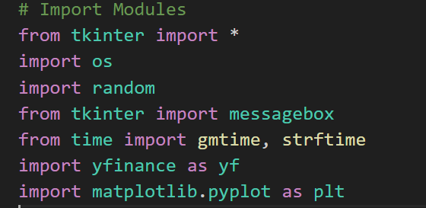
MODULES USED

Slide 8
IMPLEMENTATION DETAILS
In the bank management system project, the user authentication module will be implemented using Python's GUI and securing users passwords in a text format on a txt file.
User credentials, including usernames and passwords, will be stored in a text file.
During the login process, the bank management system validates user credentials by comparing the entered username and password with stored data. Subsequently, it verifies the entered password against the stored password. If both the username is valid and the password matches, the system grants access; otherwise, access is denied. After login it performs the set amount of functions on user's demand.

Slide 9
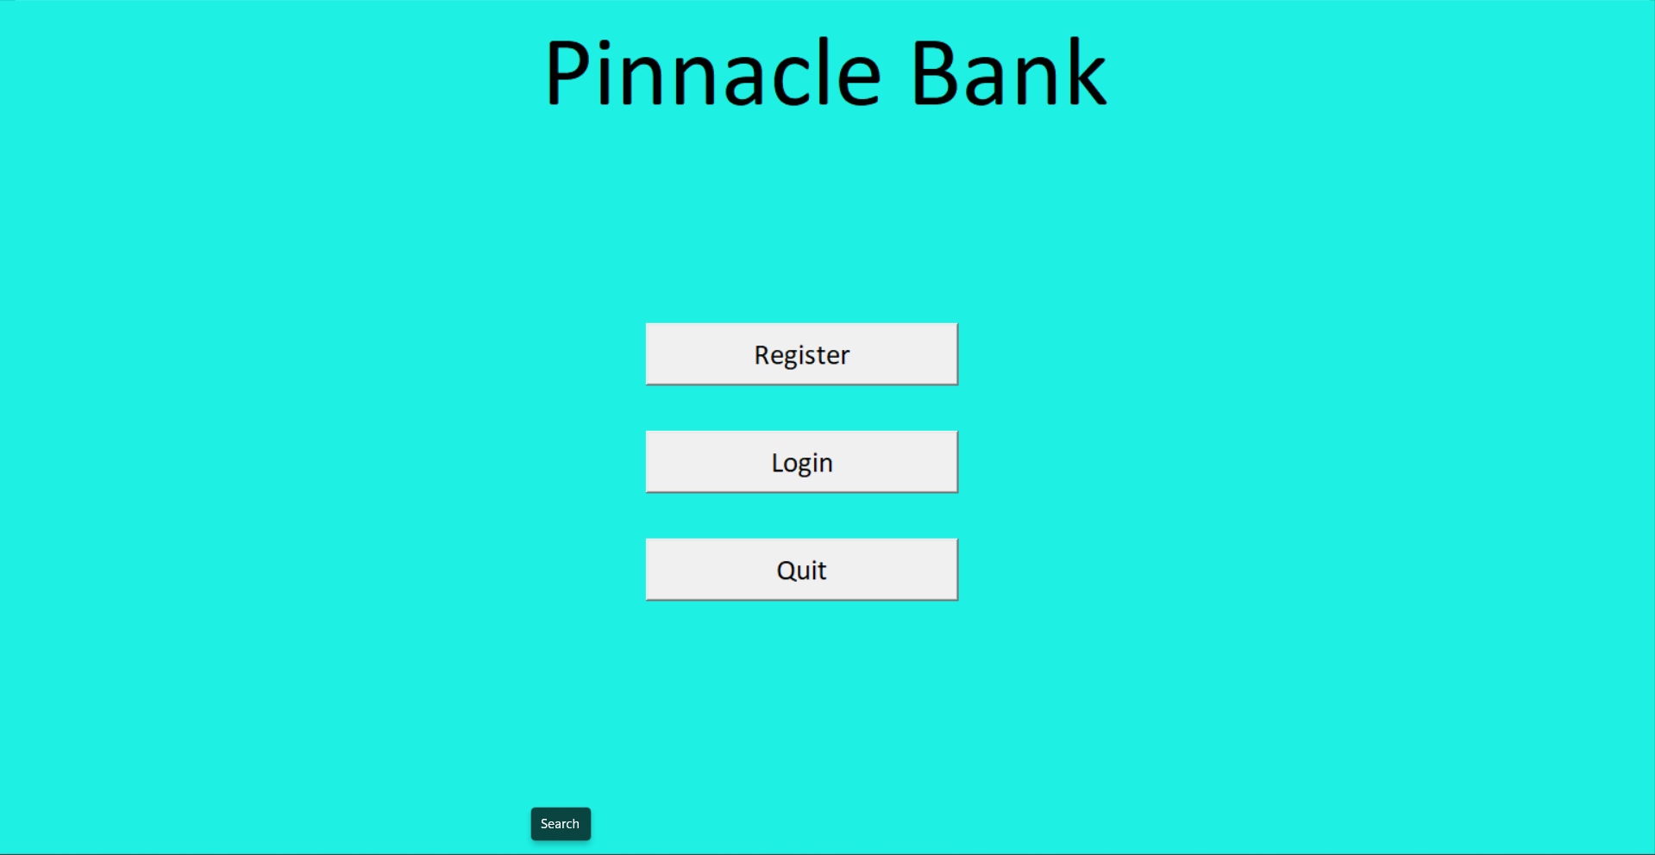
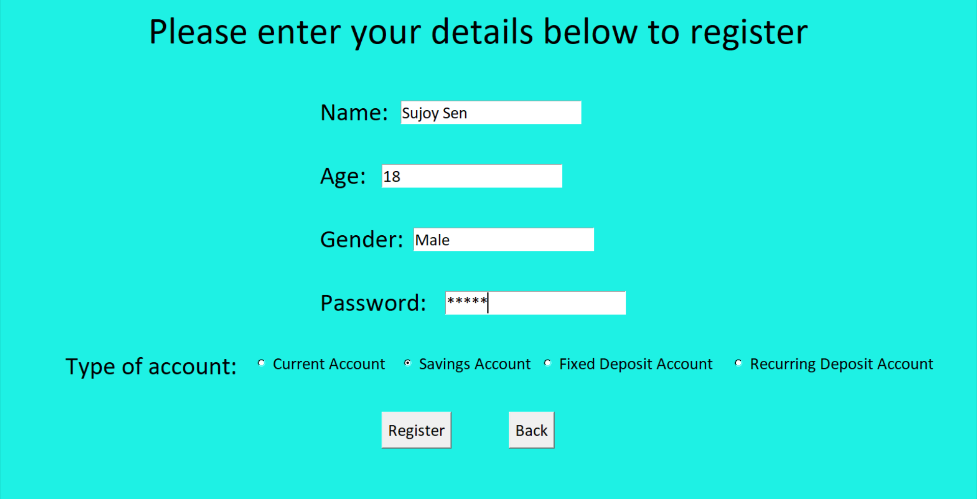
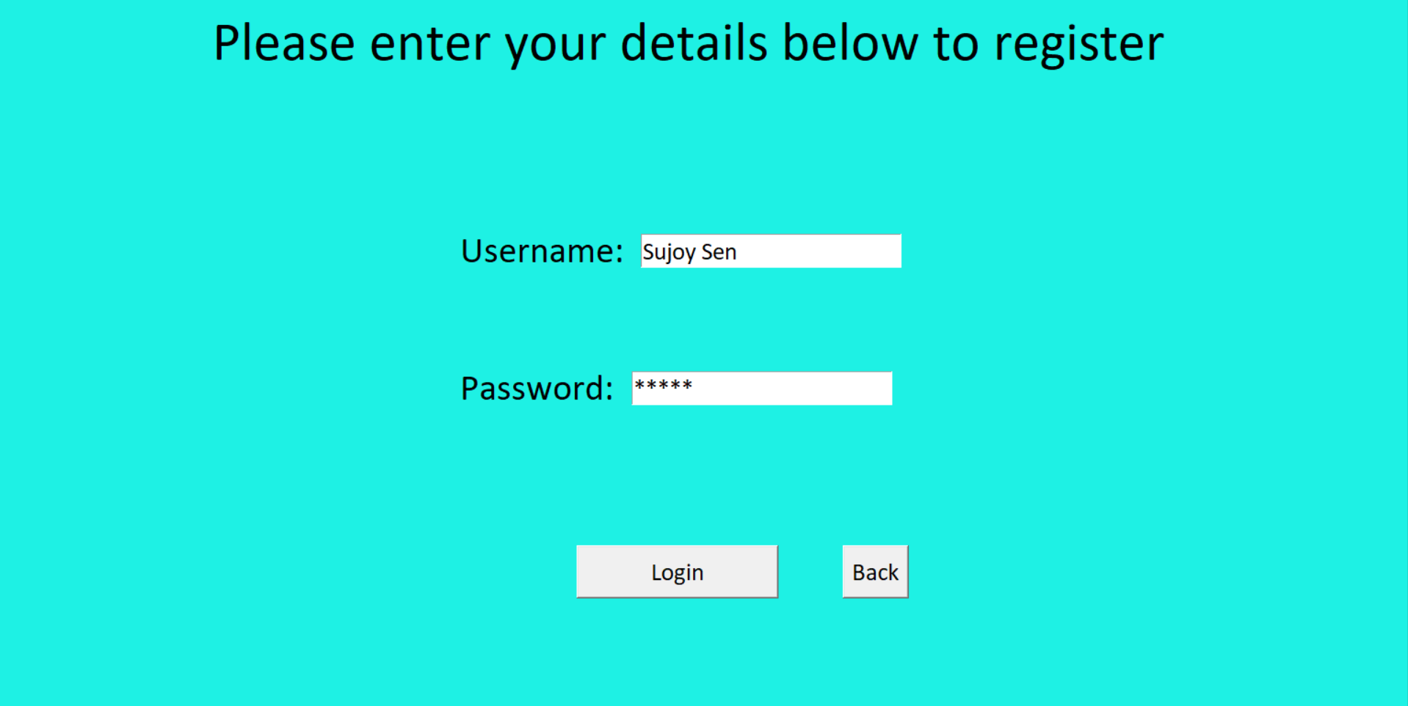
RESULTS AND DISCUSSION

Slide 10
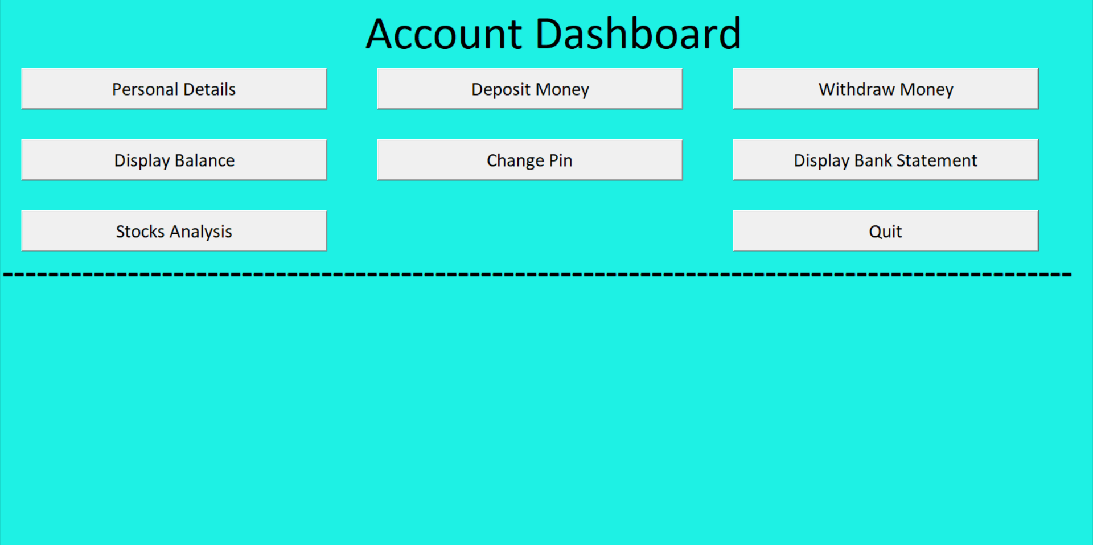
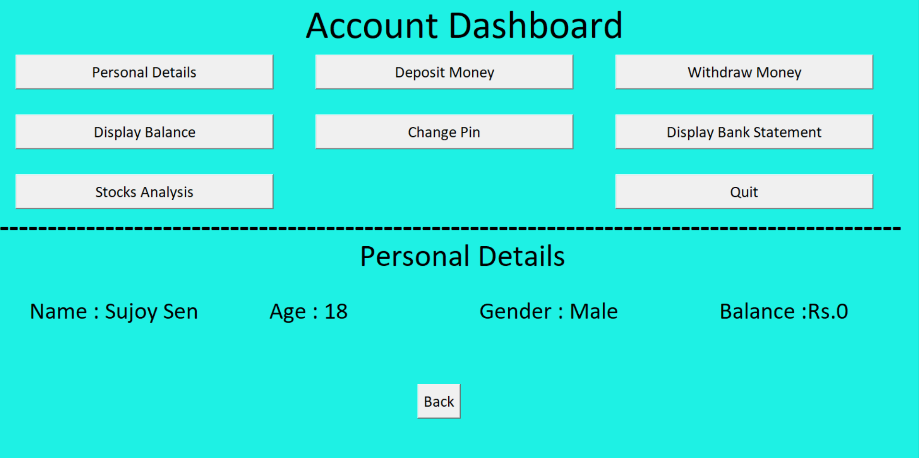
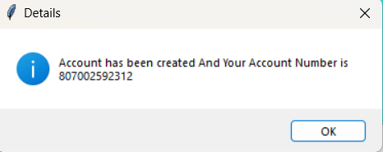
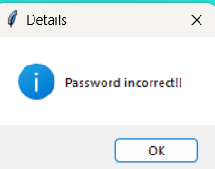
RESULTS AND DISCUSSION

Slide 11
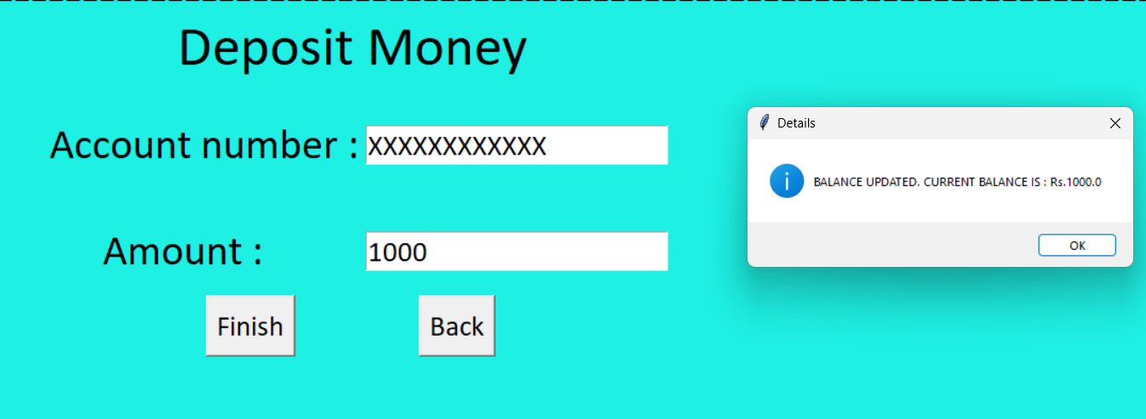
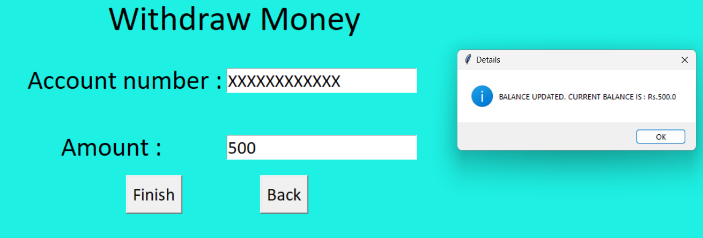
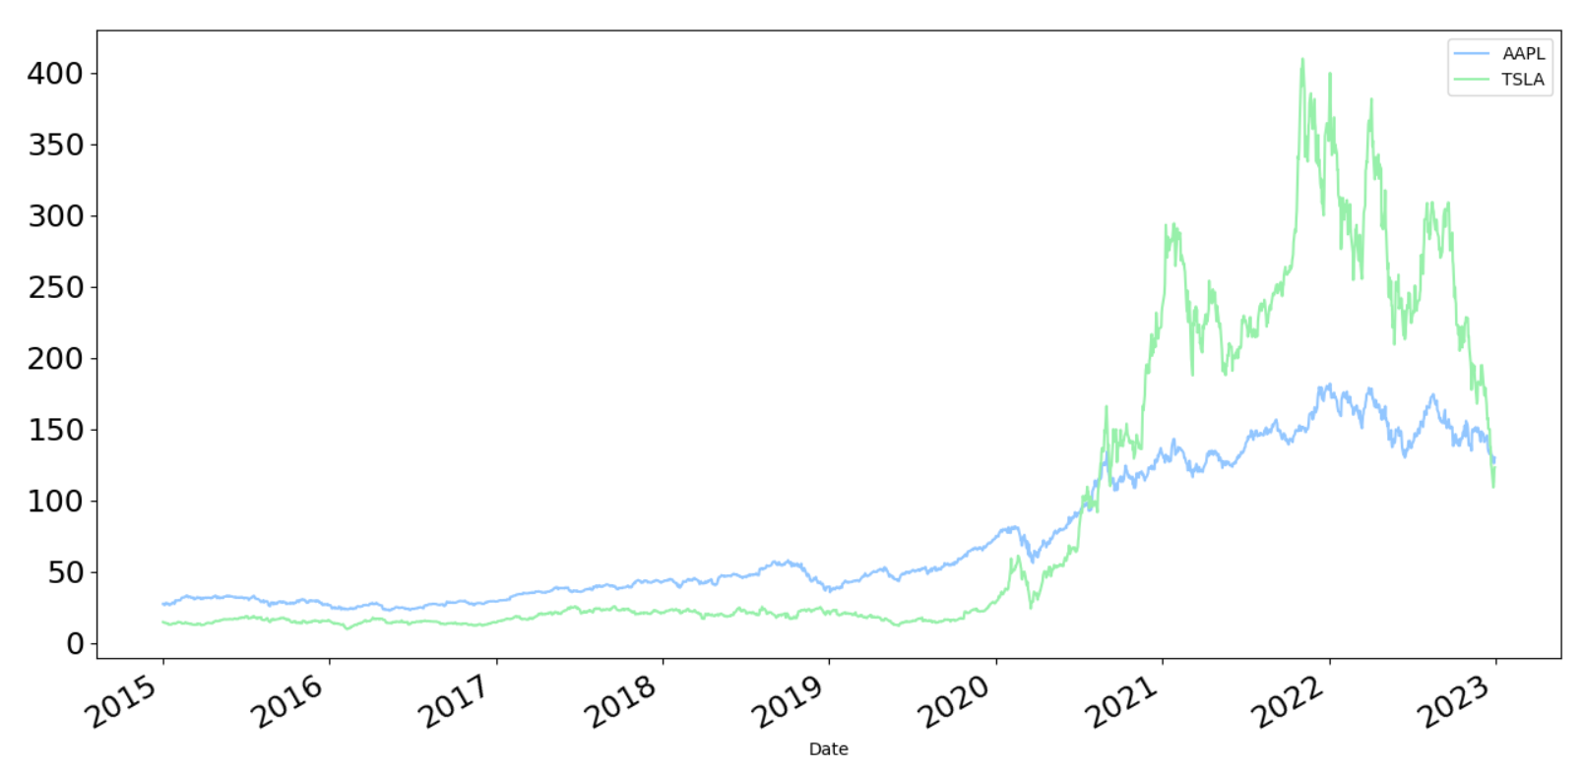
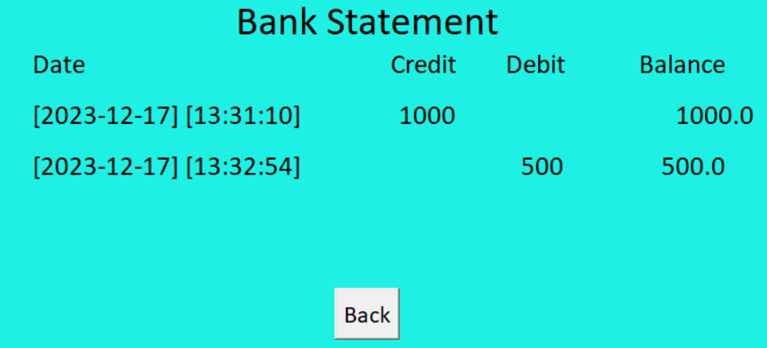
RESULTS AND DISCUSSION

Slide 12
LEARNING FROM THIS PROJECT
Through the Python project on the bank management system, we gained valuable insights into various aspects of software development.
We learned how to implement user authentication, manage data in a text file, and ensure secure login procedures.
Additionally, the project enhanced our understanding of coding practices.
Overall, this experience provided a practical application of Python programming skills and a deeper understanding of building functional and secure systems for managing banking operations.

Slide 13
CONCLUSION
Applied Python programming skills in a practical project setting.
Successfully implemented features like user authentication and secure login procedures.
Managed and organized data effectively for the bank management system.
Deepened understanding of software development practices.
The project serves as a valuable foundation for future coding projects and development challenges.

Slide 14
FUTURE WORKS
The knowledge and skills acquired through this bank management system project will undoubtedly shape my future work in software development. The hands-on experience with user authentication, secure login procedures, and effective data management will serve as a solid foundation. These insights into software development practices, gained through practical application, will guide my approach in creating functional and secure systems. The lessons learned from this project will be directly applicable, providing confidence and proficiency in addressing challenges and contributing meaningfully to future coding projects.

Slide 15
REFERENCES
Geek for Geeks: https://www.geeksforgeeks.org/python-programming-language/
Python Documentation: https://docs.python.org/3/

Slide 16
Thank You

